Slide 1
Week 3 Notes
PHY495: Hoop Never Misses

Slide 2
What I’ve Done
Tried to start the Monte Carlo simulation with the side view of the 2d shot
Tried to plot the different ideal backboard angles for a series of random shots

Slide 3
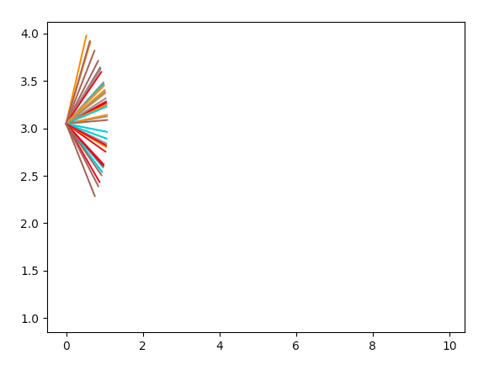
What Worked
Got a plot of different backboard angles – don’t entirely know if this is a correct graph, but it’s something!

Slide 4
Where am I Stuck
I’m mainly struggling thinking through the code (I think mainly the order of where I’m trying to figure out what)
We want to show the backboard at different angles for different locations (not all going through the same point). But to plot the backboard angles for different locations, we need to know where the ball hits the backboard. But it hits the backboard at different places for different initial shots (and we’re trying to optimize the backboard angle for all these shots). – show code

Slide 5
What Next?
Get Monte Carlo code fully working in 2D

Slide 6
Sources
SPEED OF SHOT - https://secretsofshooting.com/physics-based-basketball-shooting/

